Slide 1


KGPT: Knowledge-Grounded Pre-Training for Data-to-Text Generation
Wenhu Chen, Yu Su, Xifeng Yan, William Yang Wang

Slide 2
Background
Data-to-Text Generation
Generating text from structured data/knowledge
Diverse Forms of Structured Knowledge
E2ENLG: generate response from dialog act
WebNLG: generate description from RDF triples
WikiBio: generate biography from info-box
TOTTO: generate sentences from multi-row table

Slide 3
Background
SOTA models on different data-to-text datasets achieve over 60 BLEU-4.
Did we already solve the task of NLG?

Slide 4
Limitations
Different tasks have their own input-output format, no unified models for all tasks.
Weak Generalization to unseen knowledges (out of vocabulary entities, unseen relations, etc).
Rely on a large amount of annotation, not suitable for few-shot setting.

Slide 5
Brainstorm
Can we use GPT-2, BART, T5?
GPT-2 is not encoder-decoder architecture.
BART, T5’s encoders are not designed to encode structured knowledge.

Slide 6
Solution
Knowledge-Grounded Pretraining
Universalize the knowledge representation.
Pretrain a large model on a knowledge-grounded text corpus.
Fine-tune on down-stream data-to-text task with only a few examples.
Our model can achieve nearly the same performance with as few as 100 samples.

Slide 7
Universalization
We unify knowledge triples, attribute-value pairs, infobox, tables into unified graph representation
Each node is the entity/value/topic.
Each edge is the relation/attribute/table header.

Slide 8
Universalization
We unify knowledge triples, attribute-value pairs, infobox, tables into unified graph representation
Each node is the entity/value/topic.
Each edge is the relation/attribute/table header.
WebNLG
<triple> Stuart_Parker_(footballer) | club | Chesterfield_F.C. <triple> 1_Decembrie_1918_University | nickname | Uab.
Chelsea
Uab
club
nickname
Stuart Parker
1 Decmbrie…

Slide 9
Universalization
We unify knowledge triples, attribute-value pairs, infobox, tables into unified graph representation
Each node is the entity/value/topic.
Each edge is the relation/attribute/table header.
E2ENLG
name[The Eagle], eatType[coffee shop], priceRange[moderate]
Coffee shop
moderate
eatType
priceRange
The Eagle

Slide 10
Universalization
We unify knowledge triples, attribute-value pairs, infobox, tables into unified graph representation
Each node is the entity/value/topic.
Each edge is the relation/attribute/table header.
WikiBio Dataset
Born | Education | Employer | Article
September 1972 | Northwestern | Houston Rockets | Morey
September
Northwestern
Born
Education
Daryl Morey

Slide 11
Universalization
Most data-to-text generation tasks can be modeled as graph-to-text problem.
We propose a graph-to-text model using GNN-based Encoder + Transformer Decoder.

Slide 12
Graph Encoder
NBA
male
plays for
gender
Q316179
(Moses Malone)
Graph Encoder
Attention
Atten
Atten
Attention
Atten
Moses Malone
Gender
Male
PlaysFor
NBA

Slide 13
Graph Encoder
NBA
male
plays for
gender
Q316179
(Moses Malone)
Graph Encoder
[TRIPLE1]
[TRIPLE2]
Attention
Attention
Moses Malone
Gender
Male
PlaysFor
NBA
Attention
Atten
Atten
Attention
Atten
Moses Malone
Gender
Male
PlaysFor
NBA

Slide 14
Graph Encoder
NBA
male
plays for
gender
Q316179
(Moses Malone)
Graph Encoder
Attention
[ENT1]
Attention
[TRIPLE1]
[TRIPLE2]
Attention
Attention
Moses Malone
Gender
Male
PlaysFor
NBA
Attention
Atten
Atten
Attention
Atten
Moses Malone
Gender
Male
PlaysFor
NBA

Slide 15
Graph Encoder
NBA
male
plays for
gender
Q316179
(Moses Malone)
Graph Encoder
[FACT1]
Attention
Attention
[ENT1]
[ENT2]
Attention
Attention

Slide 16
Transformer Decoder
Malone
Copy?
Attention
[FACT1]
[ENT1]
[TRIPLE1]
Moses
Malone
Gender
Male
[TRIPLE2]

Slide 17
Pre-training
Construct Pseudo Graph-to-Text Pairs.
WikiData (Knowledge Graph)
Wikipedia (Text)
WikiData -> Hyperlink -> Wikipedia

Slide 18
Data Construction
Houston Rockets
Moses Malone, Hakeem Olajuwon, and James Harden have been named the NBA's Most Valuable Player while playing for the Rockets, for a total of four MVP awards.

Slide 19
Data Construction
Houston Rockets
Moses Malone, Hakeem Olajuwon, and James Harden have been named the NBA's Most Valuable Player while playing for the Rockets, for a total of four MVP awards.
Moses Malone
Hakeem Olajuwon
query
James Harden
Most Valuable Player

Slide 20
Data Construction
Houston Rockets
Moses Malone, Hakeem Olajuwon, and James Harden have been named the NBA's Most Valuable Player while playing for the Rockets, for a total of four MVP awards.
Moses;Harden;Hakeem
Description: American Basketball Player
Harden
MVP
Hakeem
Moses
Houston Rockets

Slide 21
Data Construction
Houston Rockets
Moses Malone, Hakeem Olajuwon, and James Harden have been named the NBA's Most Valuable Player while playing for the Rockets, for a total of four MVP awards.
Moses;Harden;Hakeem
Description: American Basketball Player
Basketball
1956
Harden
inception
award
instance of
sports
awarded
MVP
Hakeem
awarded
NBA
awarded
plays for
gender
male
Moses
instance of
position
human
member of
Power Forward
Houston Rockets

Slide 22
Data Selection
Data Selection
The crawled sentences might have low relevance with the constructed knowledge subgraph.
We perform another round of filtering to obtain the more relevant (Graph, Text) pairs.

Slide 23
Data Construction
Lexical Overlap
Rome
Europe
Berlin
capital
Continent
capital
Italy
Germany
country
instance
Roma F.C.
Football
Club
Data Selection
He was born in Italy and raised in Germany.
Bad: No Grounding, Few Lexical Overlap
✕

Slide 24
Data Construction
Lexical Overlap
Rome
Europe
Berlin
capital
Continent
capital
Italy
Germany
country
instance
Roma F.C.
Football
Club
Data Selection
A.S Roma is a football club based in Rome, Italy.
Good: Grounding, Strong Lexical Overlap
✓

Slide 25
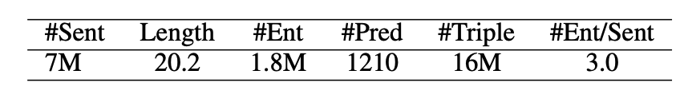
KGTEXT
The filtered 7M KGTEXT dataset contains distantly supervised (Graph, Text) pairs.

Slide 26
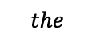
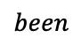
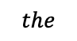
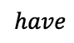
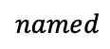
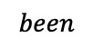
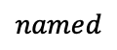
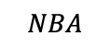
Pretrain-Finetune
Pre-training
Attention
$$been$$
$$named$$
$$the$$
$$NBA$$
Encoder
Decoder
Embedding
$$have$$
$$been$$
$$named$$
$$the$$

Slide 27
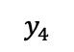
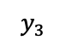
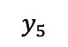
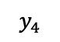
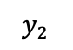
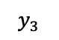
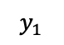
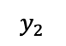
Pretrain-Finetune
Pre-training
Attention
$$been$$
$$named$$
$$the$$
$$NBA$$
Encoder
Decoder
Embedding
$$have$$
$$been$$
$$named$$
$$the$$
Initialize
Fine-Tuning
Attention
$$y_{2}$$
$$y_{3}$$
$$y_{4}$$
$$y_{5}$$
Encoder
Decoder
RDF Triples
Attribute-Value Pairs
Embedding
Semi-Structured Tables
$$y_{1}$$
$$y_{2}$$
$$y_{3}$$
$$y_{4}$$

Slide 28
Experimental Results
Datasets:
WebNLG
E2ENLG
WikiBio
Setting
Fully-Supervised
Few-Shot
Zero-Shot

Slide 29
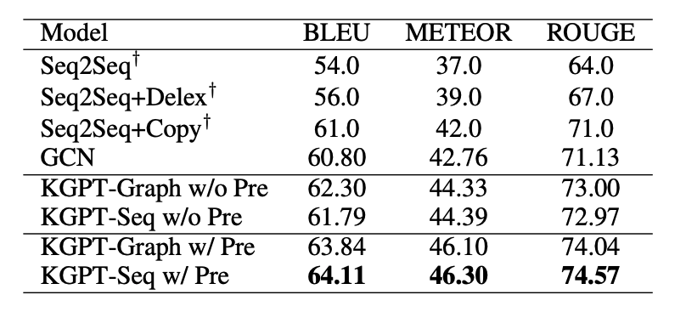
Fully-Supervised (WEBNLG)

Slide 30
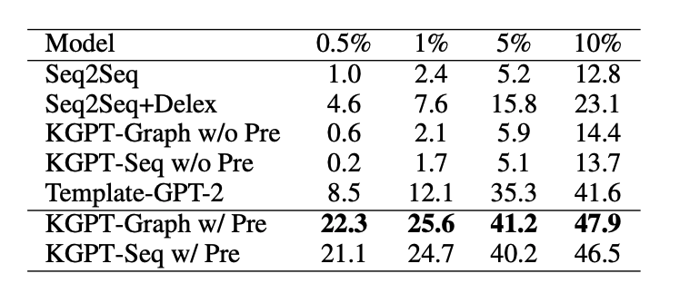
Few-shot Results (WebNLG)

Slide 31
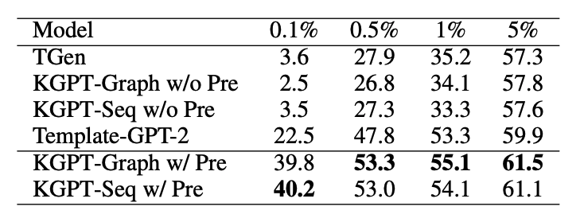
Few-shot Results (E2ENLG)

Slide 32
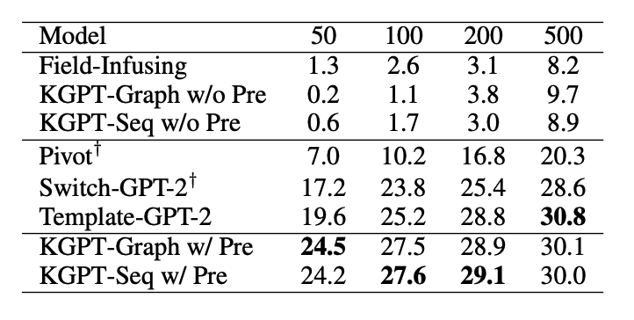
Few-shot Results (WikiBio)

Slide 33
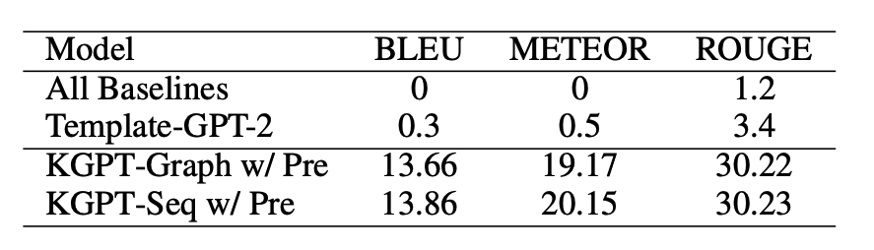
Zero-Shot Results (WebNLG)

Slide 34
Conclusion
KGPT can improve the fully-supervised results by a remarkable margin.
KGPT pretraining can significantly boost the few-shot performance by over 30 BLEU.
KGPT performs better than the other GPT-2 based models though requiring significantly fewer compute resources for pre-training.

Slide 35
Takeaway Message
We are the first to propose knowledge-grounded text generation models.
KGPT can be adapted to a wide range of knowledge-grounded generation tasks.
KGPT model has strong generalization to understand unseen knowledge inputs.

